Slide 1
How to Build a Winning Basketball Team
Future GMs:
Patrick Dancel
Andy Felicitas
Jay Mandavia
Lorenzo Yniguez

Slide 2
The Game of Basketball
Basic Rule: Score more points than the other team in 48 minutes / overtime
Examples:

Slide 3
Current State
Over the past decade, basketball has experienced a proliferation of data and metrics:
PER
+/-
Adjusted Plus-Minus
Approximate Value
Assist Percentage
Defensive Plus-Minus.
Defensive Rating
`
All Individual Stats!!

Slide 4
There’s no “I” in Team
Which team metrics have the highest correlations to wins?
Which team metrics have the lowest correlation to wins?
Which team metrics were we most surprised by?
Basketball is a TEAM sport

Slide 5
Trust the Process
Exploration /Cleanup Process
Researched internet for data
ProbasketballAPI , Stats.NBA, Basketball Reference, Kaggle
Imported json, csv/excel in pandas aggregate data in
Data for 3 seasons; 2014 – 2017 for all teams
Analysis Process
Correlations between established offensive and defensive metrics and wins
Correlation between newly created offensive and defensive metrics
Rank correlations
Notes:
Used APIs and copy / paste (Excel to csv) to aggregate data

Slide 6
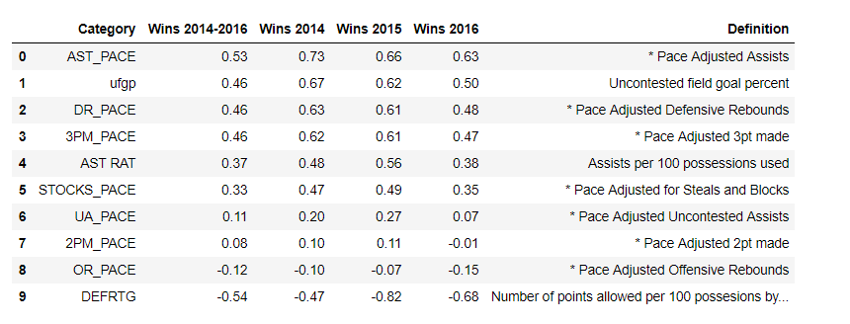
Correlations / Analysis
Notes:
Used APIs and copy / paste (Excel to csv) to aggregate data

Slide 7
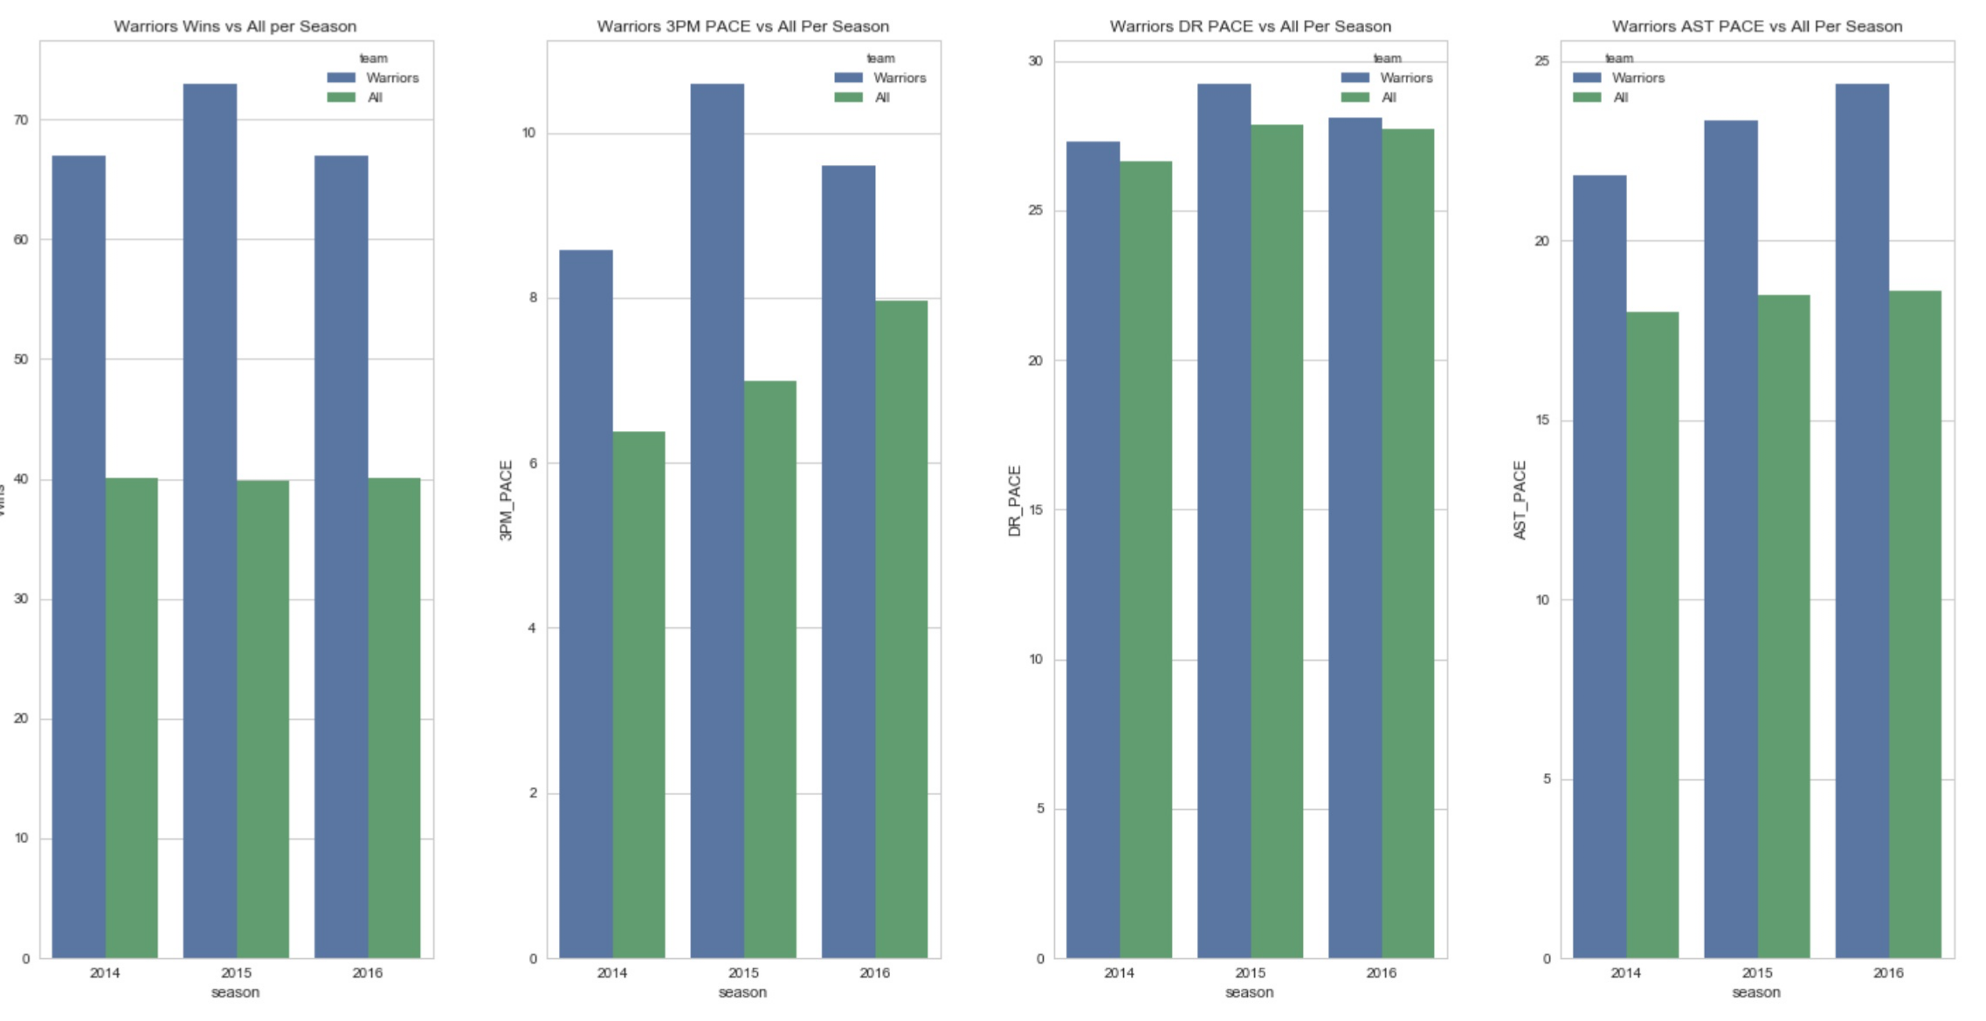
Positive Correlations
Key Takeaways
3PM / Pace – Avg 34% higher than the field for all three seasons
DR / Pace – Avg 3% higher than the field for all three seasons
Assists / Pace – Avg 25% higher than the field for all three seasons
Notes:
Used APIs and copy / paste (Excel to csv) to aggregate data

Slide 8
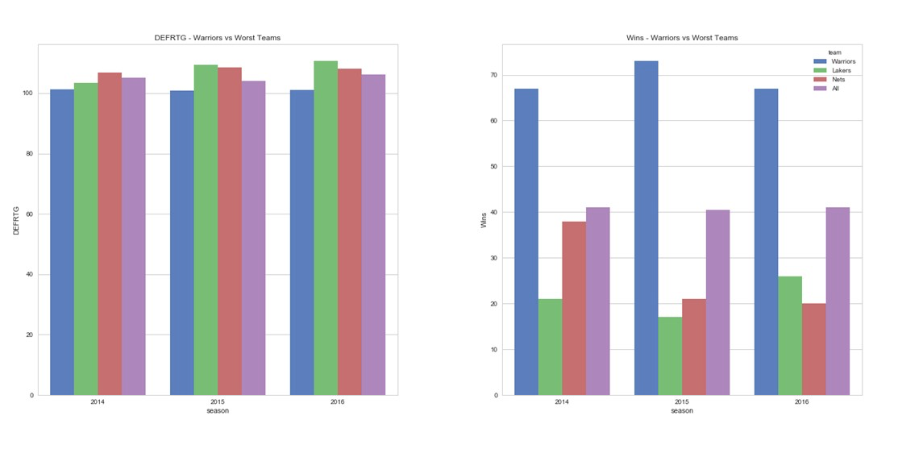
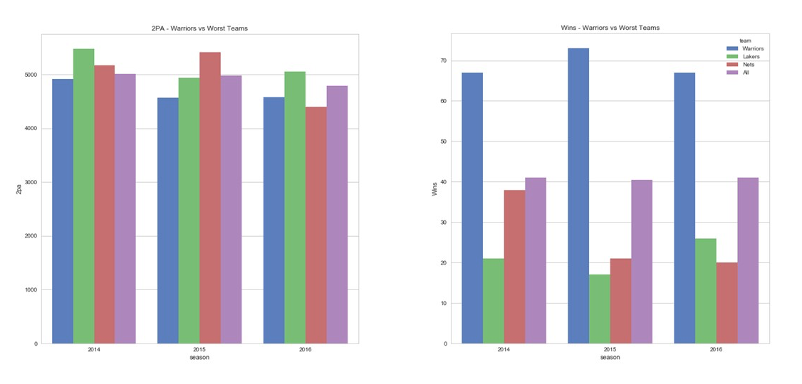
Negative Correlations
Defensive Rating
2PM / Pace
Notes:
Used APIs and copy / paste (Excel to csv) to aggregate data

Slide 9
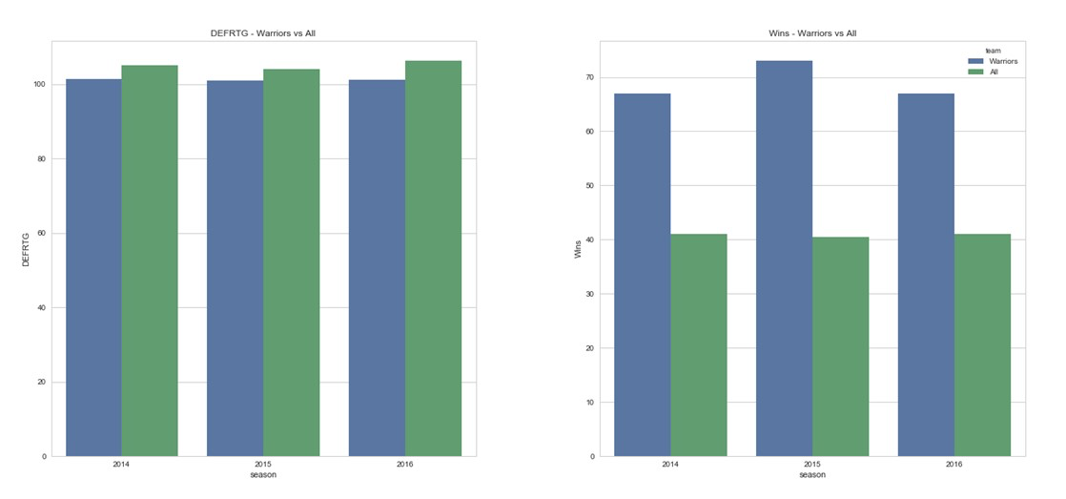
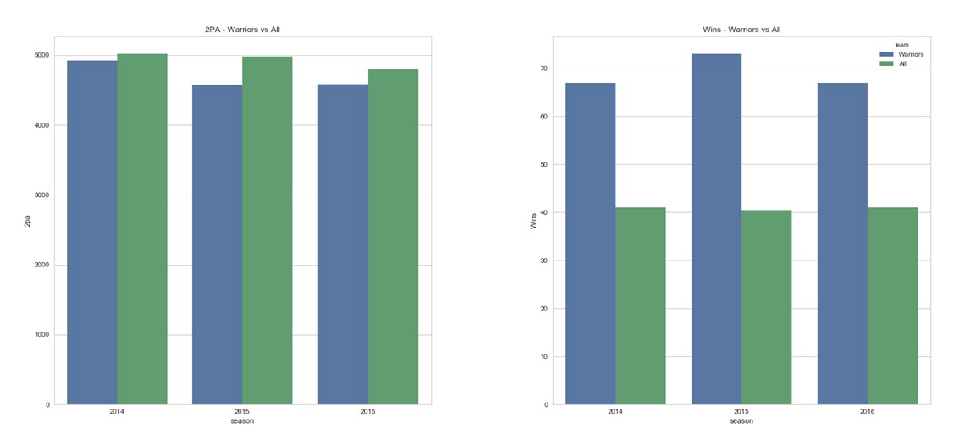
Negative Correlations
Defensive Rating
2PM / Pace
Notes:
Used APIs and copy / paste (Excel to csv) to aggregate data

Slide 10
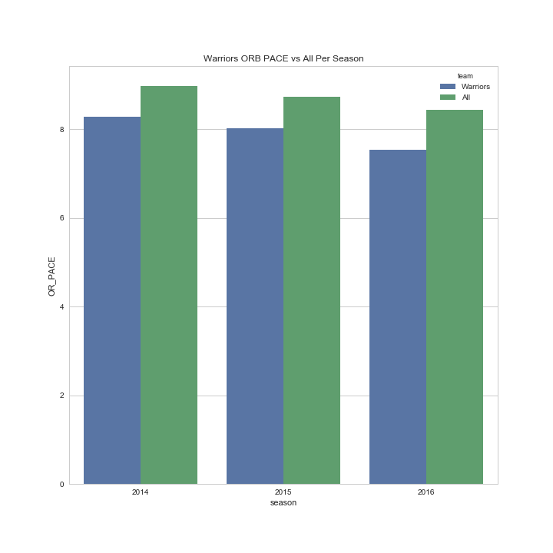
Negative Correlations
Offensive Rebounds
Key Takeaways
Defense Rating– Avg 4% less than the field for all three seasons
2PM / Pace – Avg 5% less than the field for all three seasons
ORB / Pace – Avg 10% less than the field for all three seasons
Notes:
Used APIs and copy / paste (Excel to csv) to aggregate data

Slide 11
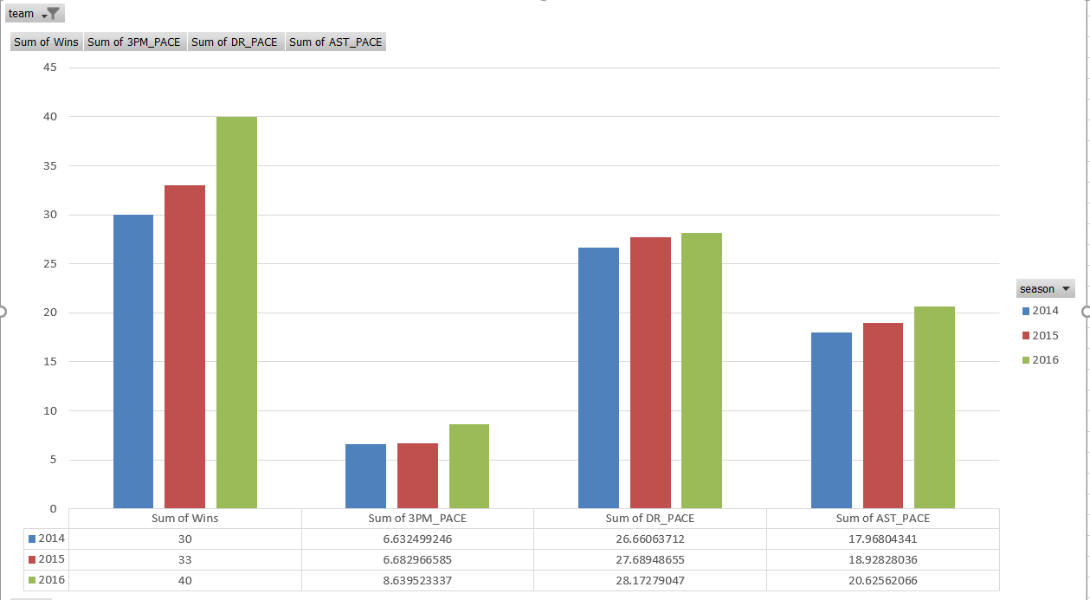
Prediction – Future Western Conference Champion: The Nuggets

Slide 12
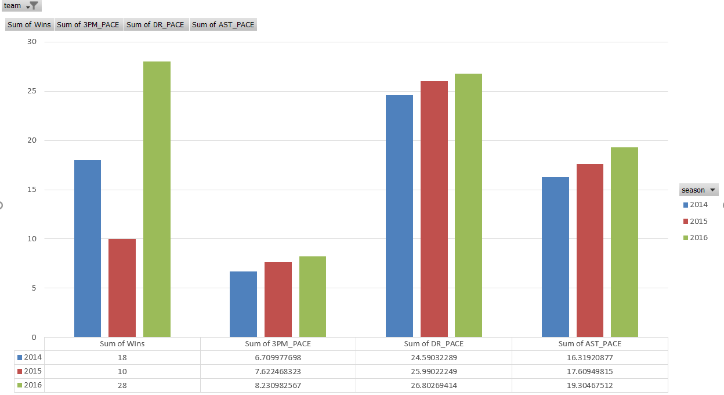
Prediction – Future Eastern Conference Champion: 76ers

Slide 13
Conclusions
Our Findings
Ball movement correlates to winning.
Faster the pace, the more opportunities for 3 point shots, rebounds and assists.
Teams that improved on our pace categories, improved on wins.
Defensive rebounds leads to more possessions and offensive opportunities.
Surprises
Defense does not win Championships!
Pace alone is not an indicator of wins. What you do with your possessions counts.
From 2014 – 2016, the correlation between 3pts made and wins has decreased.

